Slide 1

AI-Generated Branding: A Game-Changer for Startups & Small Businesses

Slide 2



Why Branding Matters for Startups & Small Businesses
Builds Trust & Recognition
Budget Constraints
AI: The Breakthrough
Traditional branding can be costly, often a barrier for new ventures with limited resources.
Leverage artificial intelligence to create professional, consistent brands efficiently and affordably.
A strong brand fosters customer loyalty and helps you stand out in a crowded market.

Slide 3

The AI Advantage: Efficiency & Cost Savings
Automate logo design, color palettes, and style guides in minutes.
Generate marketing content and social media posts instantly, streamlining your outreach.
Save up to 60-70% of time spent on branding tasks, as validated by McKinsey research.
Significantly reduce costs by avoiding expensive agencies or freelancers, making professional branding accessible.

Slide 4
Real Impact: AI Levels the Playing Field
75%
AI Tools
Looka & Canva
Improved Profit Margins
Competitive Edge
Democratizing Design
That's the percentage of small businesses experimenting with AI reporting better profitability.
AI enables startups to compete with established brands on speed, creativity, and market presence.
Platforms like these make professional-grade design accessible to everyone, regardless of budget.

Slide 5

Enhanced Creativity & Consistency with AI
AI acts as a powerful brainstorming partner, suggesting fresh ideas and brand concepts aligned with your core business values. It analyzes market trends and competitor branding to help you avoid common pitfalls.
Crucially, AI ensures a consistent brand voice and visual identity across all your marketing channels, from your website to social media, building a cohesive and memorable presence.

Slide 6
Personalized Branding at Scale
Data Analysis
1
AI processes vast amounts of customer data to understand preferences and behaviors.
Tailored Messaging
2
Craft brand messages and visuals that resonate deeply with specific customer segments.
Targeted Campaigns
3
Launch highly effective campaigns that speak directly to individual customer needs and desires.
Boost Engagement
4
AI-driven personalization, like tailored email content, significantly increases customer interaction and conversion rates.

Slide 7
AI Tools Powering Startup Branding Success
Here are some leading AI tools helping startups and small businesses elevate their branding efforts:
Logo & Visual Identity
Content Creation
Brand Strategy & Social Media
Looka: AI-powered logo maker and brand kit builder.
ChatGPT: Versatile AI for generating text content, headlines, and ideas.
HubSpot AI: Offers insights into market trends and audience behavior for strategic branding.
Tailor Brands: Comprehensive branding platform for logos, websites, and business cards.
Jasper AI: AI writing assistant for marketing copy, blog posts, and ad campaigns.
Buffer AI / Lately AI: Tools for optimizing social media content and scheduling posts.

Slide 8
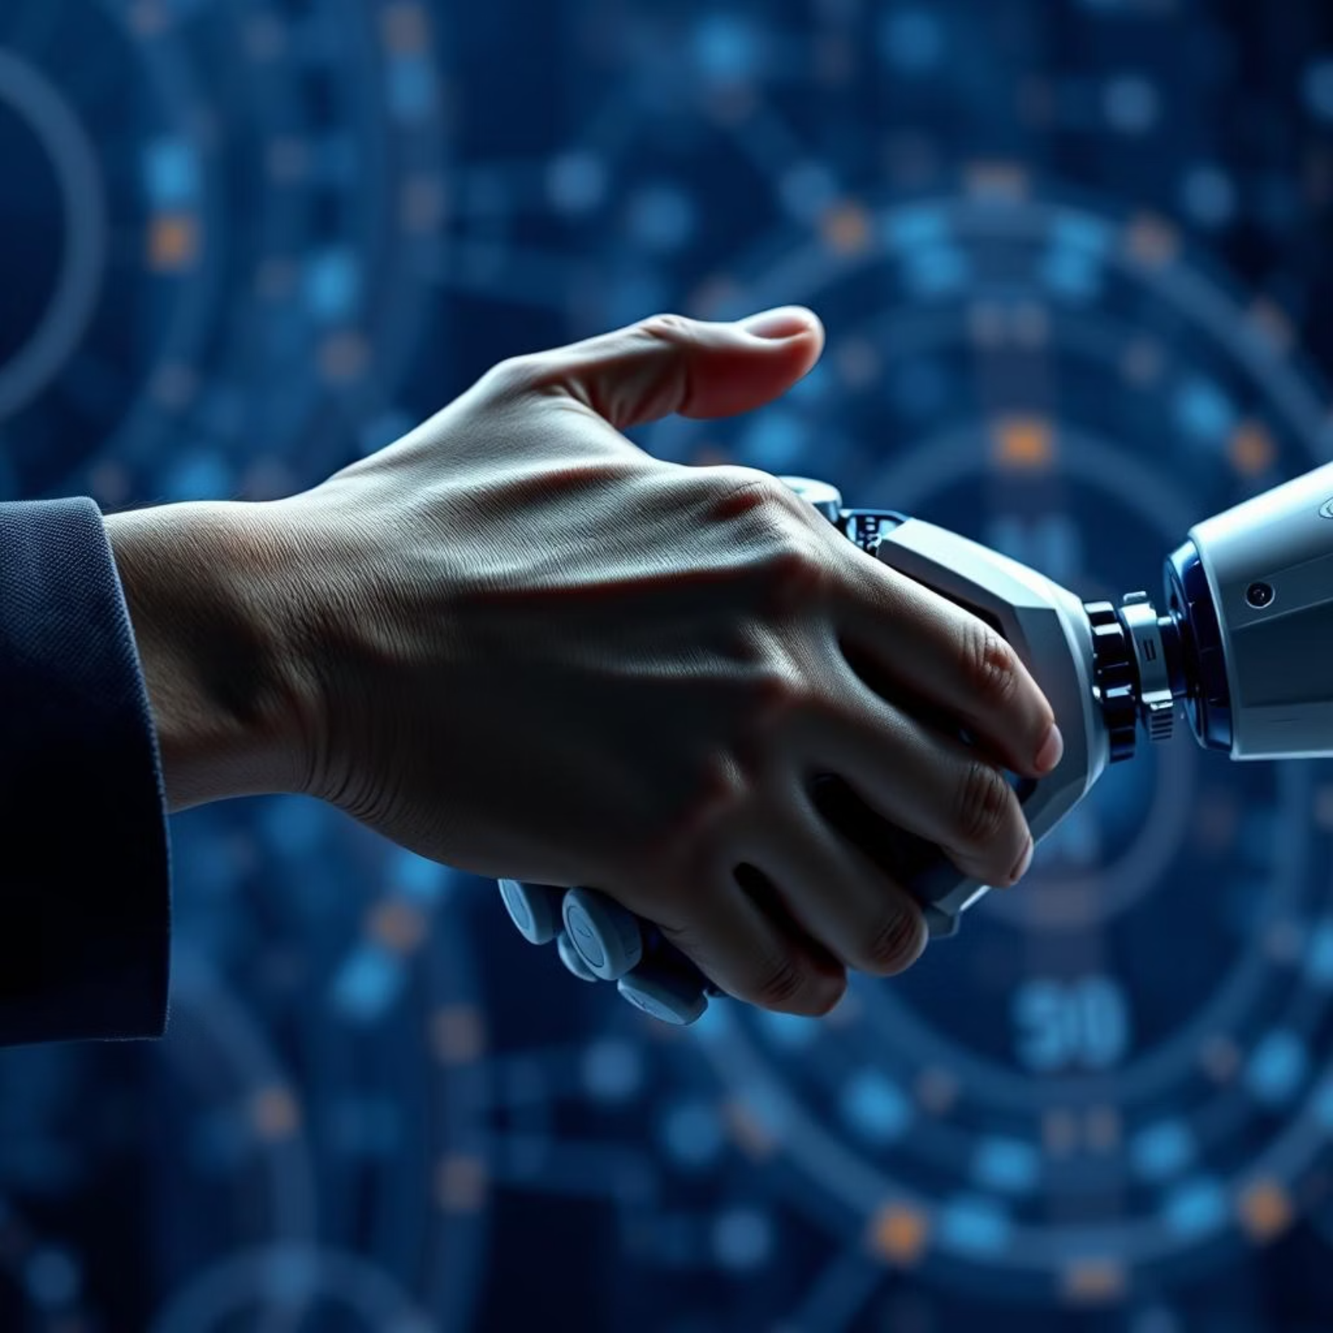
Overcoming Challenges: Human + AI Collaboration
AI is a copilot, not a replacement. The most successful branding strategies blend AI's efficiency with authentic human creativity and insight.
To maximize AI's positive impact, focus on clear brand guidelines and ongoing training for your team. This ensures AI output aligns perfectly with your brand's unique identity.

Slide 9
Getting Started: Simple Steps for Startups
01
02
Define Your Needs
Choose User-Friendly Tools
Clearly identify your specific branding goals and what you want to achieve with AI.
Select AI platforms known for their ease of use, often with free trials to explore features.
03
04
Start Small
Iterate & Refine
Begin by automating just one branding task, like logo generation or social media captions, to build confidence.
Continuously gather team feedback and leverage AI insights to improve and evolve your brand.

Slide 10
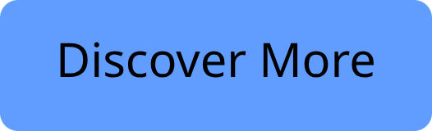

The Future is Now: Empower Your Brand with AI
AI-generated branding unlocks growth, creativity, and a competitive edge for every venture.
Startups and small businesses can now build memorable, impactful brands faster and smarter than ever before. Embrace AI today to transform your brand and accelerate success.

